Slide 1
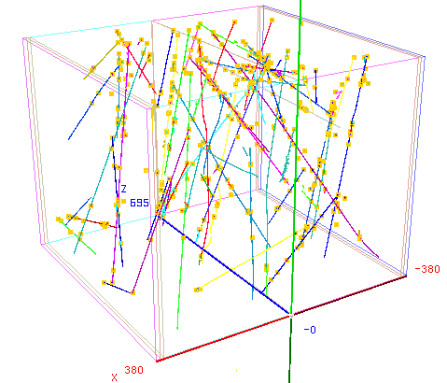
Introduction to LArTPC event reconstruction
Andy Chappell for the Pandora team
09/11/2022 7th UK LArTPC Software and Analysis Workshop

Slide 2
Reconstruction session
Talk
Exercise
Exercise
Talk
Introduction to Pandora
Running the reconstruction
Visualizing the inputs
Pandora’s algorithms
Exercise
Talk
Exercise
Visualizing the algorithms
Pandora’s outputs
Pandora’s outputs in LArSoft
Credit: These slides are based on previous
LArSoft workshop slides by John Marshall
Key references: Pandora ProtoDUNE paper Pandora MicroBooNE paper

Slide 3
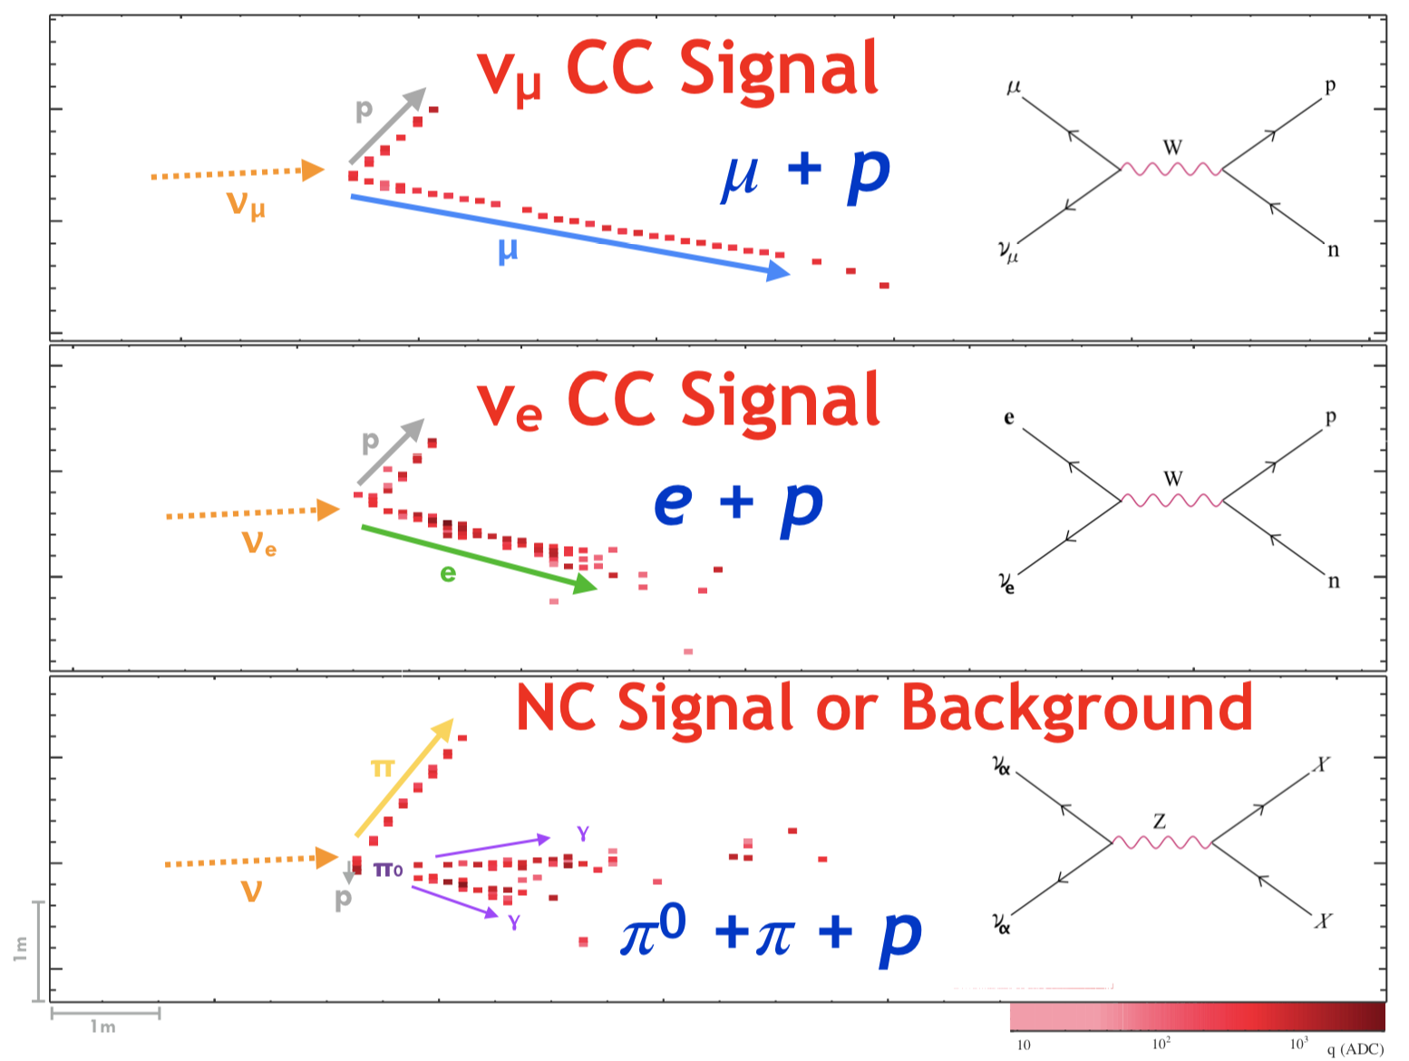
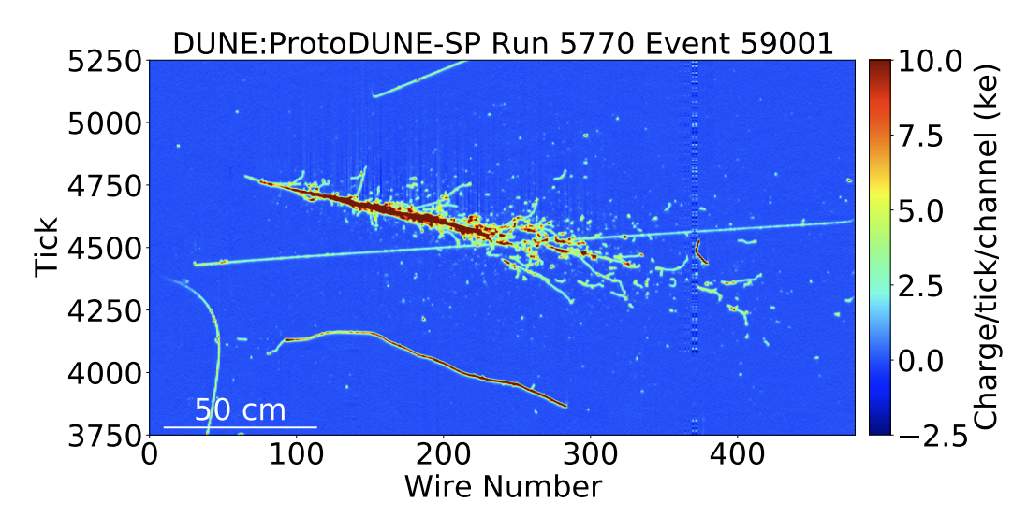
Neutrino detectors
CDHS
NoVA
ProtoDUNE-SP
New Frontiers in High-Energy Physics, pp227-261
DOI: 10.5281/zenodo.1286758
B. Abi et al 2020 JINST 15 P12004
Evolving detector technologies, with a general trend towards imaging neutrino interactions
Emphasis on identifying and characterizing individual visible particles
Physics sensitivity now depends critically on both hardware and software
Need a sophisticated event reconstruction to harness information in the images
Aim to reconstruct hierarchy of particles of identified types, with measured four-momenta
“Particle flow” reconstruction

Slide 4
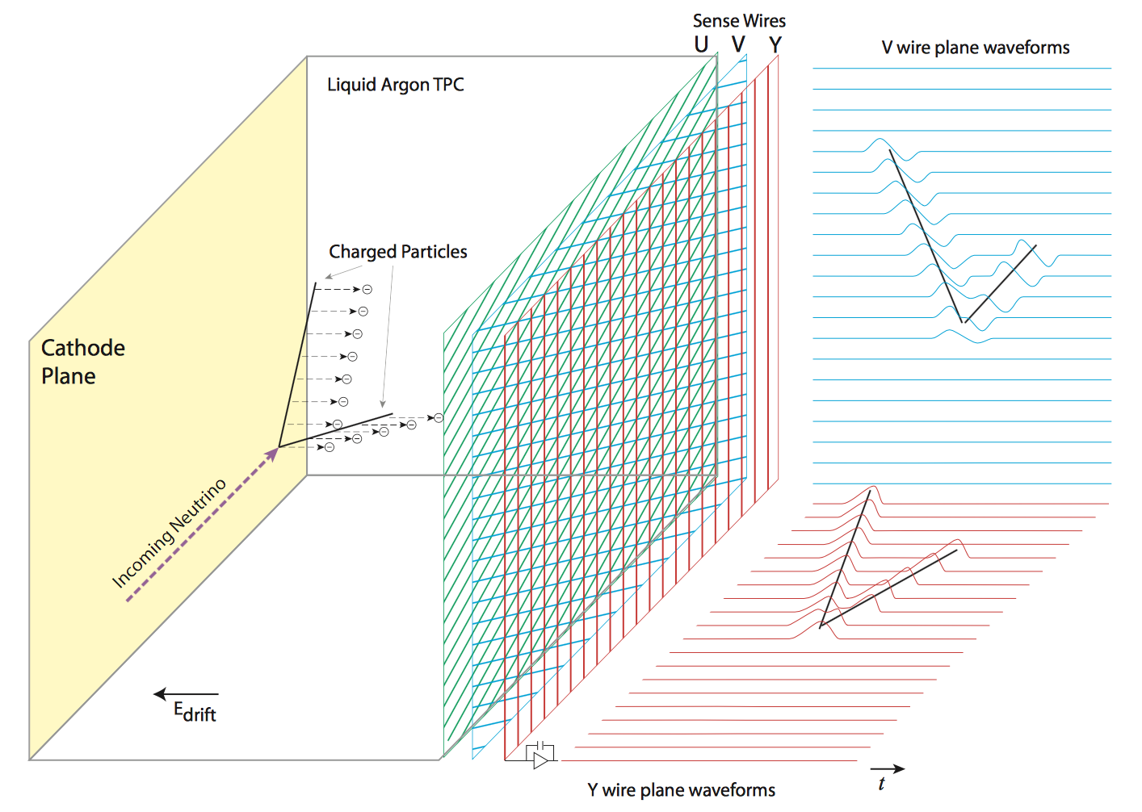
LArTPC detectors
Charged particles deposit ionization trails in liquid argon
Ionization electrons drift in an applied electric field
Electrons are detected by a series of readout planes (wire planes in this example)
LArTPC detectors:
Past: ICARUS, ArgoNeuT, ProtoDUNE-SP/DP
Current: MicroBooNE, LArIAT, ICARUS@SBN
Coming soon: SBND, ProtoDUNE-HD
arxiv:1612.05824

Slide 5
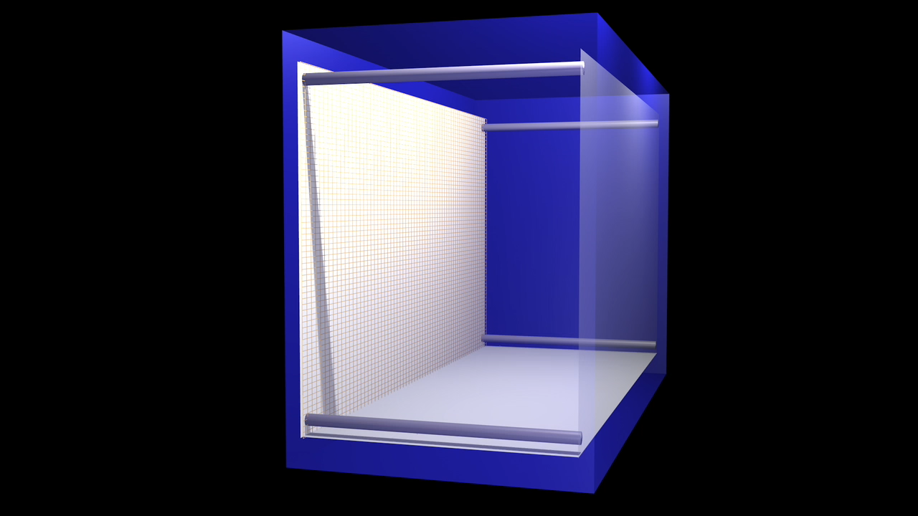
LArTPC detectors

Slide 6
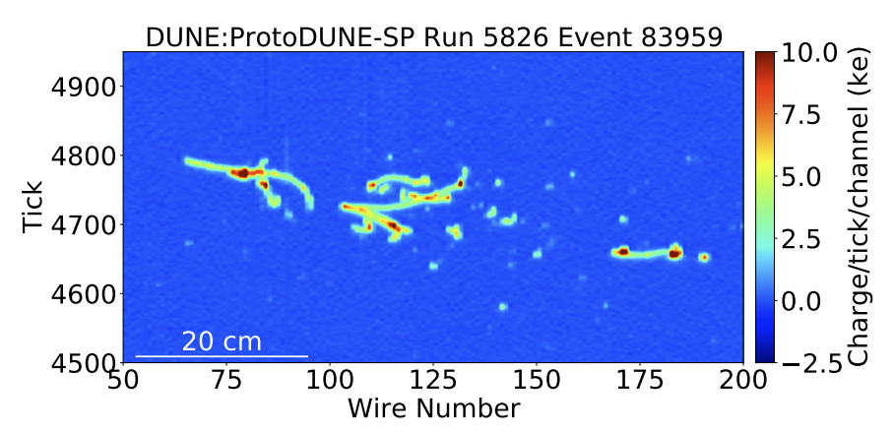
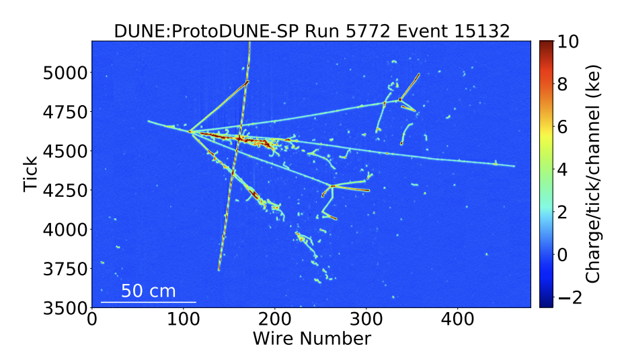
LArTPC detectors
The conversion of raw LArTPC images into analysis-level quantities:
Low-level steps:
Noise filtering
Signal processing
Pattern recognition:
The bit you do by eye!
Turn images into sparse 2D hits
Assign 2D hits to clusters
Match features between planes
Output a hierarchy of 3D particles
High-level characterisation:
Particle identification
Neutrino flavour and interaction type
Neutrino energy, etc…

Slide 7
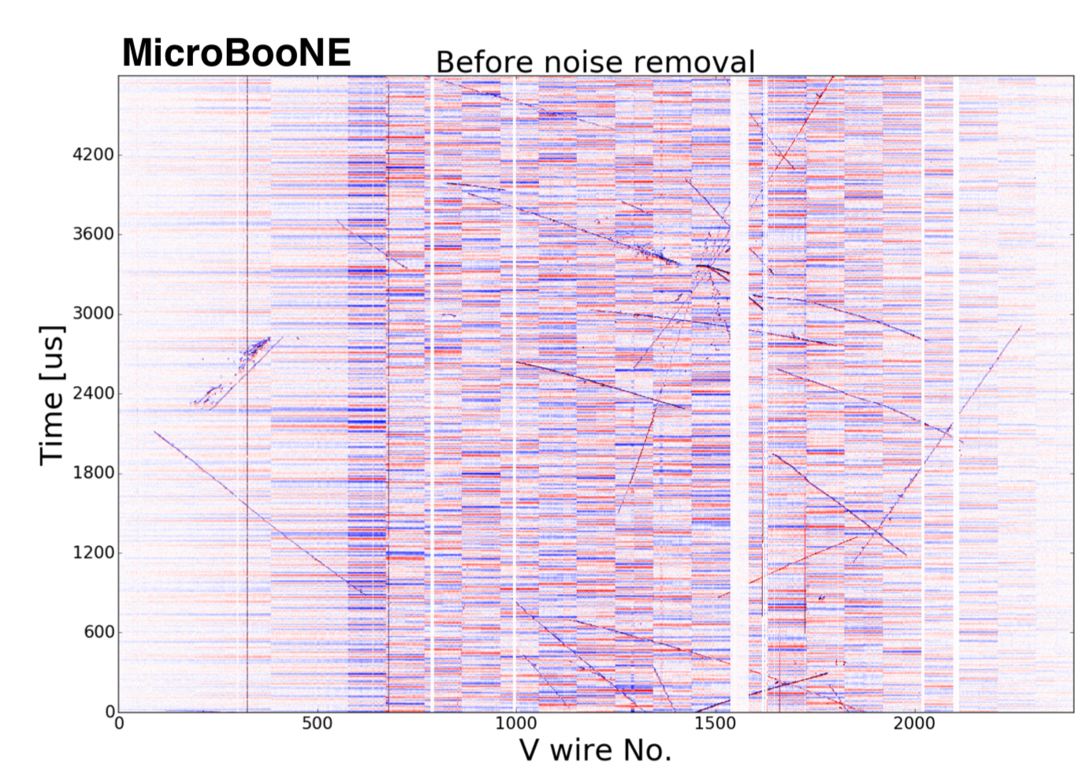
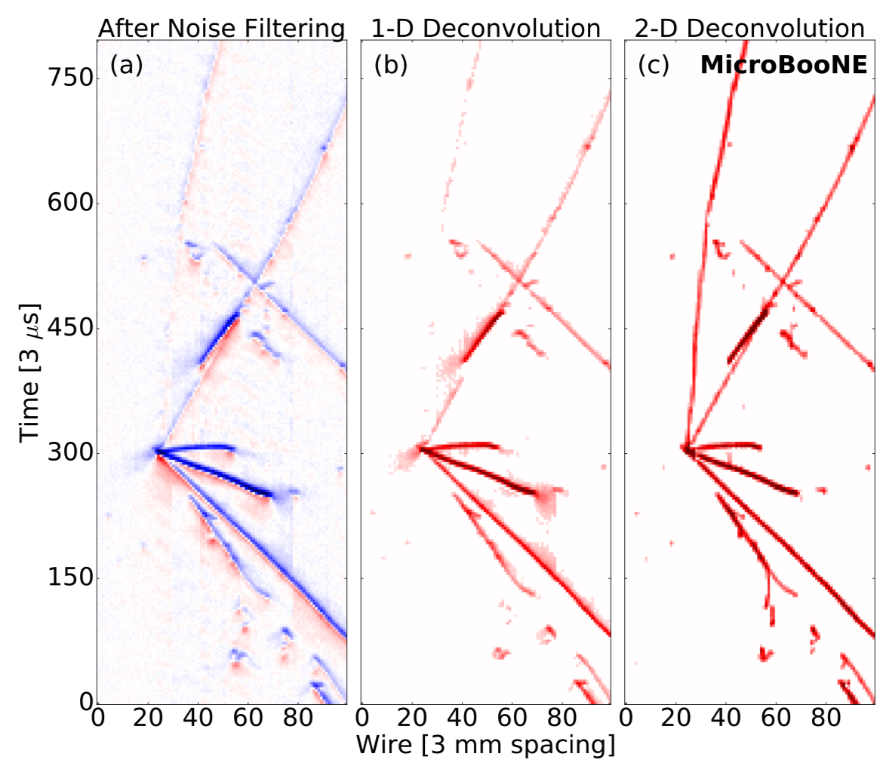
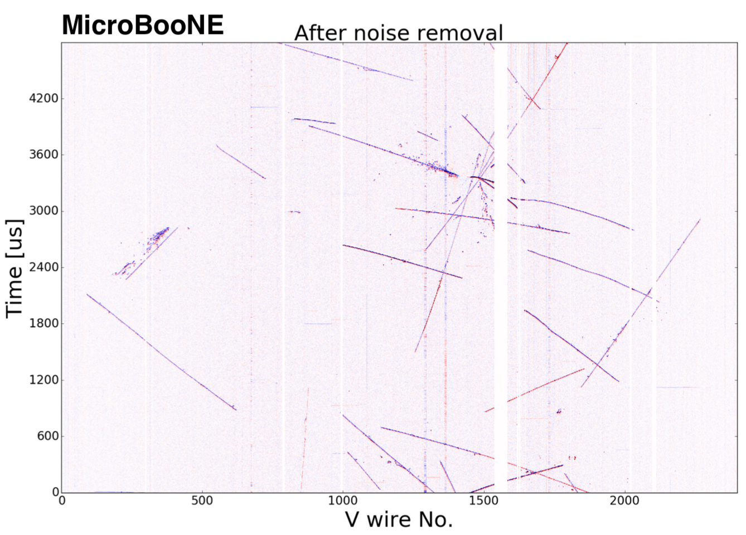
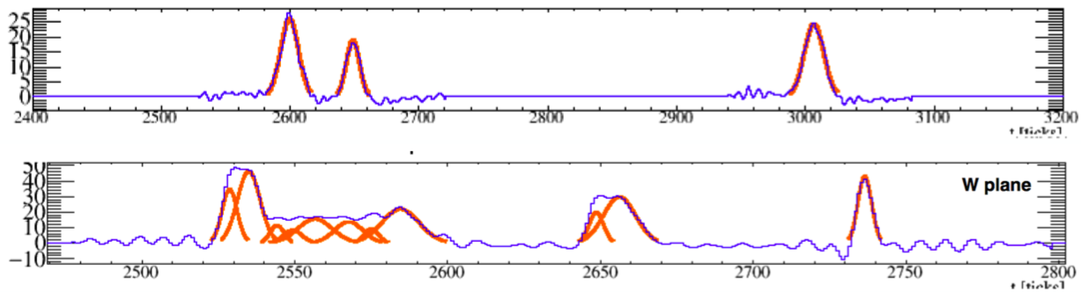
Event reconstruction – low-level
Noise filtering
Signal processing
Convert digitized TPC waveform to number of ionization electrons passing through a wire plane at a given time (via deconvolution)
Filter out external noise, correct some distortions
Hit finding
Fit clean waveform with N Gaussians, where N is number of peaks in a pulse. Each Gaussian represents a hit.
Processed waveforms
T. Yang (ICHEP 2016)
Reconstructed hits

Slide 8
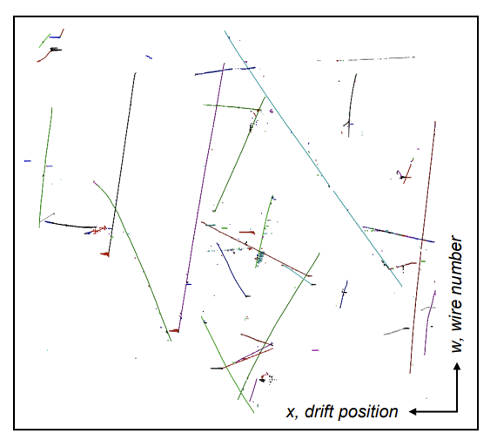
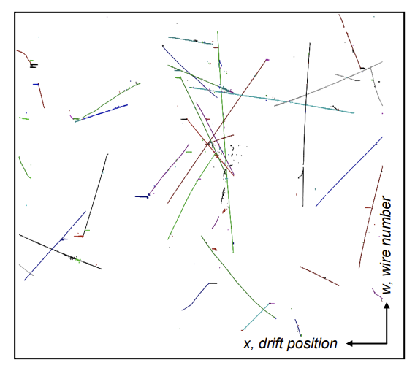
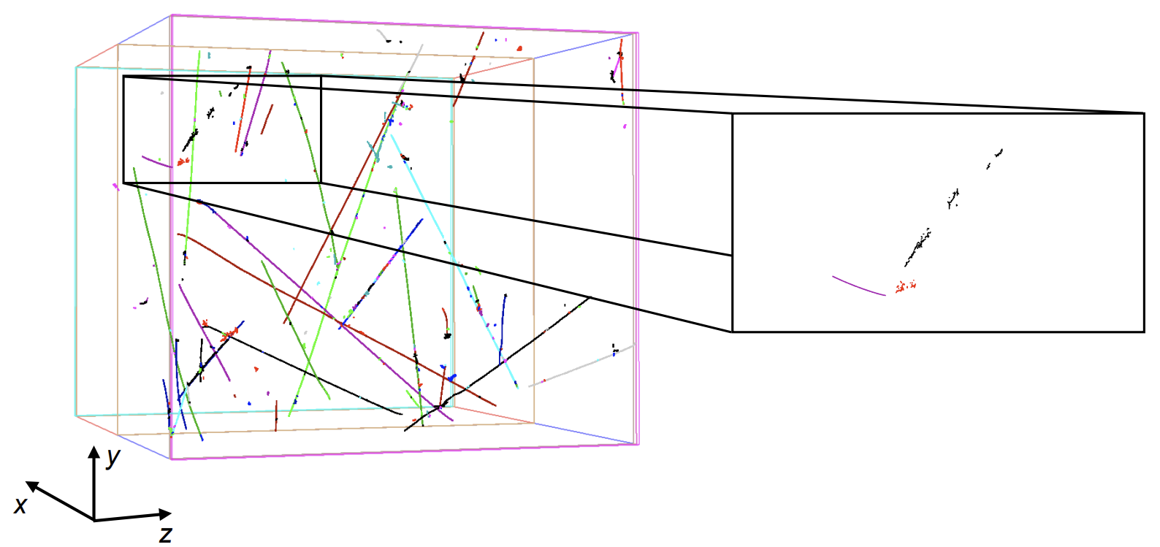
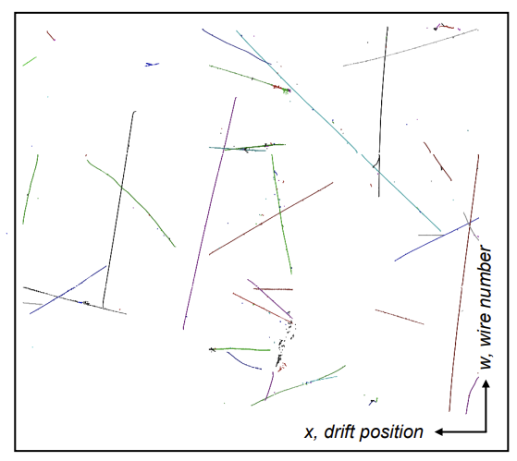
Event reconstruction – pattern recognition
Main aims of the pattern recognition step are to:
Produce 3D reconstructed particles, based on inputs of 3 x 2D images
Reconstruct the hierarchy of particles resulting from an interaction.
ProtoDUNE-SP Data
Candidate 1 GeV π⁺ event
π⁺ track (purple) comes in from left and produces π⁰ decay photon showers (red and black)
Output from hit finding
L. Whitehead

Slide 9
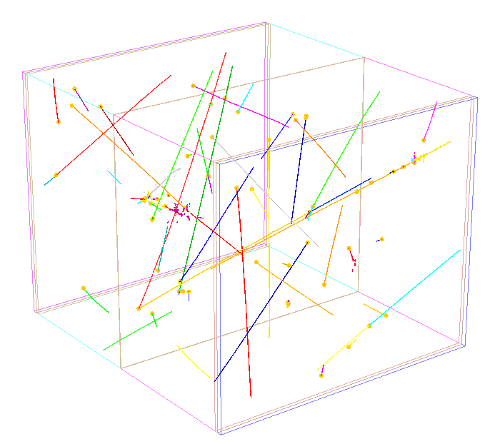
Event reconstruction – high-level characterisation
Particle ID
PID from dE/dx
Start/End for separation
(e/γ and μ/K/p)
Calorimetry
dE/dx from ionisation
π⁰ Mass Reconstruction
Neutrino Interactions
Flavour ID
Background rejection
Energy estimation
Michel Electron Studies
ProtoDUNE-SP Simulation
Energy Estimation
Muons
EM showers
Hadronic activity
Track Fitting
Trajectory determination
Momentum from multiple Coulomb scattering for exiting tracks
Slide: S. Green

Slide 10
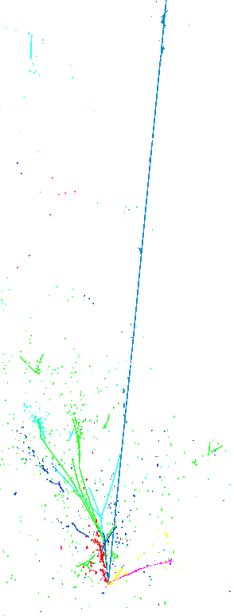
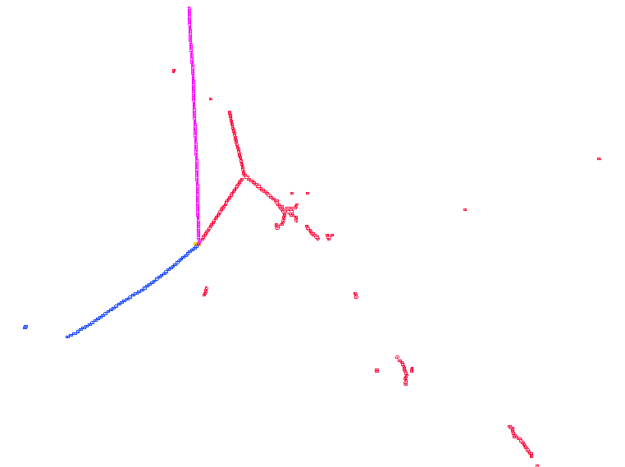
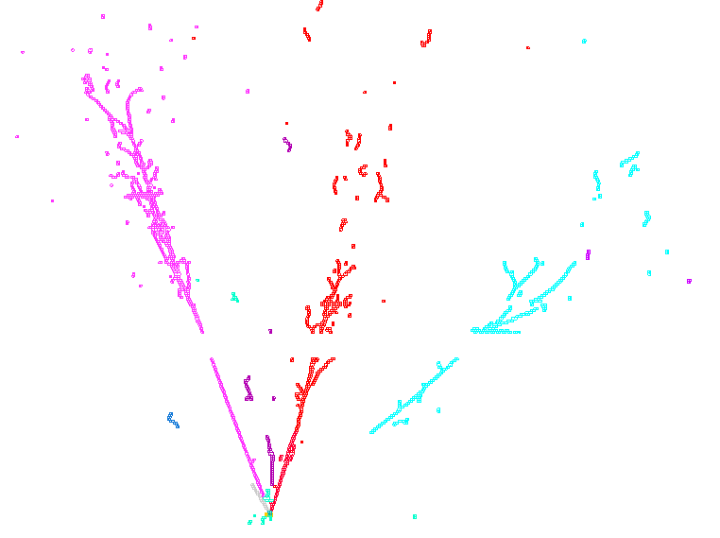
Event reconstruction – focus on pattern recognition
It is a significant challenge to develop automated, algorithmic LArTPC pattern recognition
1.8 GeV ν_{μ} CC RES
w, wire
10 cm
24.8 GeV ν_{μ} CC DIS
x, time
10 cm
50 cm
3.3 GeV ν_{e} CC DIS
Complex, diverse topologies
Long exposures due to long drift times (up to a few milliseconds)
Significant cosmic-ray muon background in surface-based detectors
ProtoDUNE-SP

Slide 11
Pandora multi-algorithm approach
Single clustering approach is unlikely to work for such complex topologies:
Mix of track-like and shower-like clusters
Pandora uses a multi-algorithm approach:
Build up events gradually
Each step is incremental - aim not to make mistakes (undoing mistakes is hard…)
Deploy more sophisticated algorithms as picture of event develops
Build physics and detector knowledge into algorithms

Slide 12
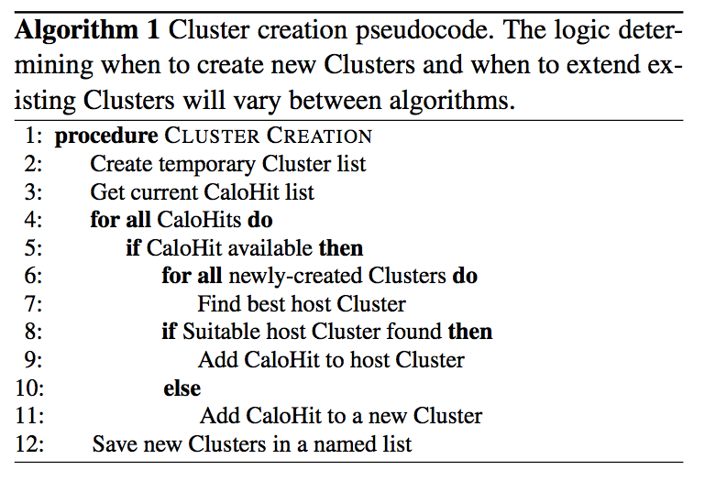
Pandora multi-algorithm approach
Algorithms contain high-level logic and concentrate on the important bits
Physics and pattern recognition ideas
Pandora software development kit (SDK) supports algorithms
Functions to access objects
Make new objects
Modify existing objects, etc.
Particle (PFO)
Child objects can be added to parent object
Example algorithm structure
MCParticle link
Cluster
Vertex
Algorithm objects
Created by algs
CaloHit
MCParticle
Event Data Model
Input objects
Created by client app

Slide 13
Pandora in LArSoft
pandora (framework, visualization)
Re-usable libraries to support multi-alg approach
Hosted on PandoraPFA GitHub
pre-built as external package by LArSoft
Pandora
Application
Algorithms
larpandora Producer module, provides translation LArSoft⟷Pandora
Hosted via LArSoft GitHub, built with mrb
larpandoracontent 100+ algorithms and tools that control the patrec
Hosted via LArSoft and PandoraPFA GitHub, can build with mrb

Slide 14
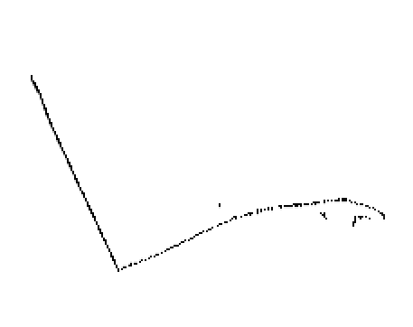
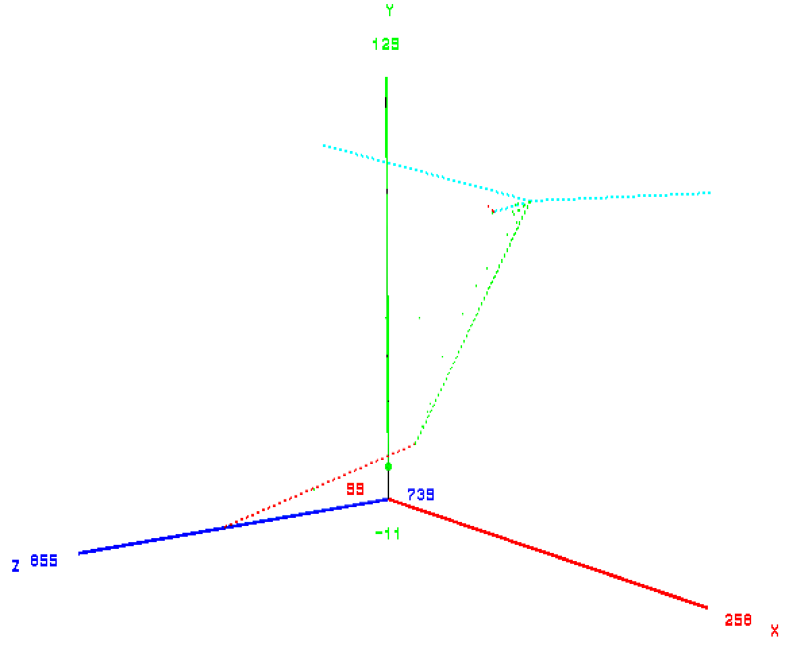

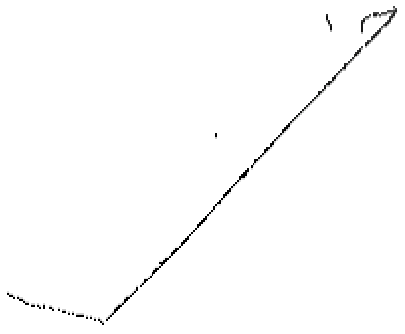
Inputs to Pandora
u, wire
CCQE: ν_{μ} + Ar → p + μ⁻
x, time
p
𝝁⁻
e⁻
𝞶𝝁
𝞶e
e⁻
v, wire
p
𝝁⁻
x, time
𝝁⁻
p
e⁻
e⁻
3D truth information
w, wire
𝝁⁻
x, time
Three 2D representations with common x coordinate, derived from drift time
p

Slide 15
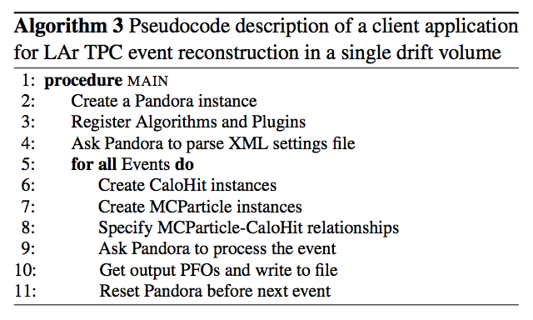
Pandora application: larpandora
The controlling application should be simple: create Pandora instance(s), register algorithms, provide a Pandora Settings XML file and handle event input/output:
In reality, often tends to get complicated (vindicating decision to separate algorithms from steps needed to access and control the inputs and outputs…)
/**
* @brief ILArPandora class
*/
class ILArPandora : public art::EDProducer
Implement as an art::EDProducer
Relevant callbacks
void beginJob();
void produce(art::Event &evt);
We will now try running the larpandora module in LArSoft

